Slide 1

DEPARTMENT OF COMPUTER ENGINEERING
Fake Review Detection for E-commerce using GNN (Group no -10)
Student: Amish Nandu (18102048)
Student: Yash Pol (19102068)
Student: Akshen Dhami (18102032)
Student: Sumati Hans (18102028)
Under the Guidance of: Prof.Bharti Khemani

Slide 2
Problem statement
To implement the GNN algorithm for e-commerce fake review identification, where fake review detection refers to the act of recognizing and misleading online reviews.
In order to prevent the review ecosystem from being used for fraudulent or promotional purposes, companies typically, take this step.
To address these problems and protect the credibility of the online review system, fake review identification is required.

Slide 3
Objective
To develop GNN architecture by defining the node and edge attributes, creating a graph representation of the data, and designing a neural network architecture for it.
To train the model by using a good optimization algorithm, we will modify the neural network's weights during training so that it can figure out how to anticipate the intended result for each input graph.
To assess the model's performance after the training, by testing it on a different set of data. This entails calculating metrics like accuracy. To comprehend the model's prediction process better, we will apply visualization tools.

Slide 4
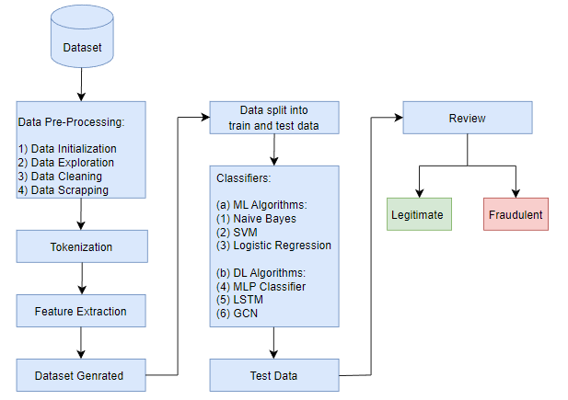
Architecture Diagram

Slide 5
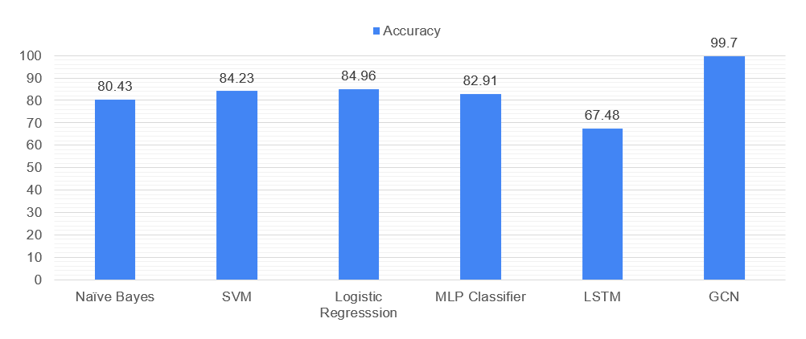
Implementation

Slide 6
Implementation

Slide 7
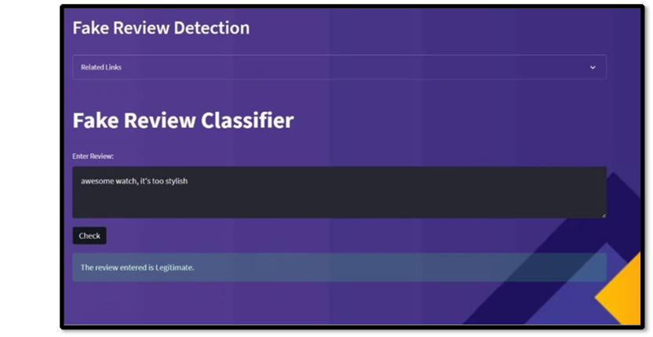
Implementation:

Slide 8
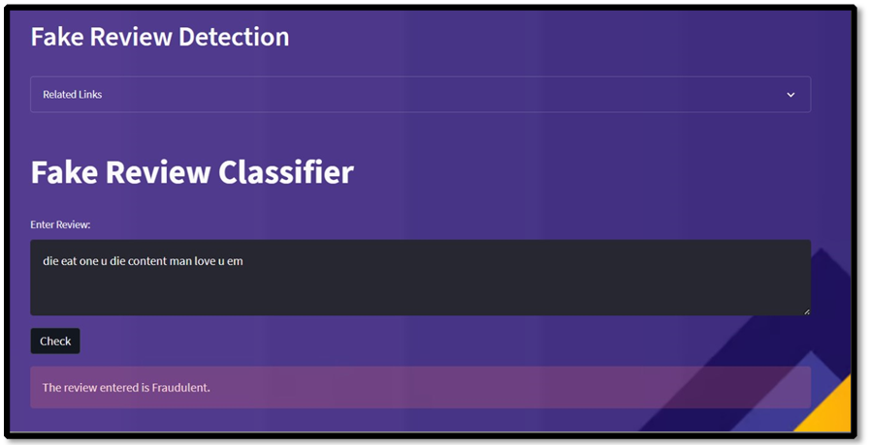
Implementation

Slide 9
Reference
Ma, Jing, Wei Gao, Zhongyu Wei, Yueming Lu, and Kam-Fai Wong. "Detect rumors using time series of social context information on microblogging websites." In Proceedings of the 24th ACM international on conference on information and knowledge management, pp. 1751-1754. 2020.
Li, Zhao, Xin Shen, Yuhang Jiao, Xuming Pan, Pengcheng Zou, Xianling Meng, Chengwei Yao, and Jiajun Bu. "Hierarchical bipartite graph neural networks: Towards large-scale e-commerce applications." In 2020 IEEE 36th International Conference on Data Engineering (ICDE), pp. 1677-1688. IEEE, 2020.
Kong, Sheng How, Li Mei Tan, Keng Hoon Gan, and Nur Hana Samsudin. "Fake news detection using deep learning." In 2020 IEEE 10th Symposium on Computer Applications & Industrial Electronics (ISCAIE), pp. 102-107. IEEE, 2020.

Slide 10
Reference
Kumar, Sachin, Rohan Asthana, Shashwat Upadhyay, Nidhi Upreti, and Mohammad Akbar. "Fake news detection using deep learning models: A novel approach." Transactions on Emerging Telecommunications Technologies 31, no. 2 (2020): e3767
Yuan, Hua, Jie Zheng, Qiongwei Ye, Yu Qian, and Yan Zhang. "Improving fake news detection with domain-adversarial and graph-attention neural network." Decision Support Systems 151 (2021): 113633.
Zeng, Hanqing, Muhan Zhang, Yinglong Xia, Ajitesh Srivastava, Andrey Malevich, Rajgopal Kannan, Viktor Prasanna, Long Jin, and Ren Chen. "Decoupling the depth and scope of graph neural networks." Advances in Neural Information Processing Systems 34 (2021): 19665-19679.

Slide 11
References
Song, Chenguang, Kai Shu, and Bin Wu. "Temporally evolving graph neural network for fake news detection." Information Processing & Management 58, no. 6 (2021): 102712.
Liu, Weiwen, Yin Zhang, Jianling Wang, Yun He, James Caverlee, Patrick PK Chan, Daniel S. Yeung, and Pheng-Ann Heng. "Item relationship graph neural networks for e-commerce." IEEE Transactions on Neural Networks and Learning Systems (2021).
Zhang, Ge, Zhao Li, Jiaming Huang, Jia Wu, Chuan Zhou, Jian Yang, and Jianliang Gao. "efraudcom: An e-commerce fraud detection system via competitive graph neural networks." ACM Transactions on Information Systems (TOIS) 40, no. 3 (2022): 1-29.

Slide 12
Publication
In regards to our publication, we've submitted a research paper to the 4th International Conference on Data Science and Applications (ICDSA 2023).

